Slide 1




ARTIFICIAL INTELLIGENCE (AI) AND MACHINE LEARNING (ML)
STUDENT DETAILS
NAME : Yash Sunil Phuke
EMAIL ID: yashphuke11@gmail.com
AICTE Internship Student Registration ID) : STU61c5637dba2041640326013
IBM Skill Build EMAIL_ID: yashphuke2512@gmail.com

Slide 2

SENTIMENT ANALYSIS OF RESTAURANT REVIEWS
THE RESTAURANT INDUSTRY HEAVILY RELIES ON CUSTOMER FEEDBACK AND REVIEWS TO MAINTAIN AND IMPROVE THEIR SERVICES.
ANALYZING THE SENTIMENT OF THESE REVIEWS CAN PROVIDE VALUABLE INSIGHTS INTO CUSTOMER SATISFACTION AND HELP RESTAURANTS MAKE DATA-DRIVEN DECISIONS TO ENHANCE THEIR OFFERINGS.

Slide 3
WHO ARE THE END USERS of this project?
Restaurant Owners and Managers:
Restaurant owners and managers can use the sentiment analysis results to gain insights into customer feedback. They can identify areas of improvement in their services, menu, or overall dining experience.
Customers and Diners:
Customers looking for dining options can benefit from the sentiment analysis results. They can make more informed decisions about where to dine based on the sentiments expressed in previous reviews.
Review Platforms and Aggregators:
Online review platforms and aggregators (e.g., Yelp, TripAdvisor) can integrate the sentiment analysis model into their services. This allows them to automatically

Slide 4
PROJECT OBJECTIVE:
THE MAIN GOAL OF THIS PROJECT IS TO DEVELOP A MACHINE LEARNING MODEL THAT CAN AUTOMATICALLY CLASSIFY RESTAURANT REVIEWS AS POSITIVE, NEGATIVE, OR NEUTRAL BASED ON THE SENTIMENTS EXPRESSED IN THE TEXT.
DATA SOURCE:
THE PROJECT WILL UTILIZE A DATASET OF RESTAURANT REVIEWS, WHICH CAN BE COLLECTED FROM VARIOUS ONLINE SOURCES SUCH AS REVIEW WEBSITES OR SOCIAL MEDIA PLATFORMS.
THE DATASET WILL INCLUDE TEXT REVIEWS AND CORRESPONDING SENTIMENT LABELS (POSITIVE, NEGATIVE, NEUTRAL).
PROJECT OBJECTIVE:
THE MAIN GOAL OF THIS PROJECT IS TO DEVELOP A MACHINE LEARNING MODEL THAT CAN AUTOMATICALLY CLASSIFY RESTAURANT REVIEWS AS POSITIVE, NEGATIVE, OR NEUTRAL BASED ON THE SENTIMENTS EXPRESSED IN THE TEXT.
DATA SOURCE:
THE PROJECT WILL UTILIZE A DATASET OF RESTAURANT REVIEWS, WHICH CAN BE COLLECTED FROM VARIOUS ONLINE SOURCES SUCH AS REVIEW WEBSITES OR SOCIAL MEDIA PLATFORMS.
THE DATASET WILL INCLUDE TEXT REVIEWS AND CORRESPONDING SENTIMENT LABELS (POSITIVE, NEGATIVE, NEUTRAL).

Slide 5
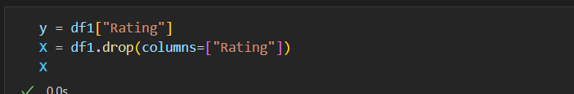
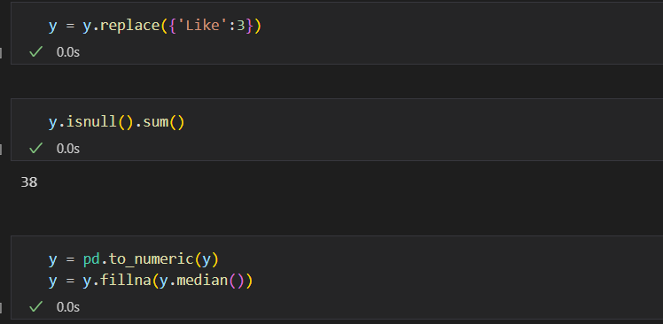
DATA PREPROCESSING:
CLEAN AND PREPROCESS THE TEXT DATA, INCLUDING TASKS LIKE REMOVING SPECIAL CHARACTERS, HANDLING CAPITALIZATION, AND TOKENIZATION.
PERFORM STOPWORD REMOVAL AND ADDRESS ANY OTHER NOISE IN THE TEXT.

Slide 6

FEATURE ENGINEERING:
CONVERT THE PROCESSED TEXT DATA INTO NUMERICAL FEATURES SUITABLE FOR MACHINE LEARNING MODELS.
EXPLORE TECHNIQUES LIKE TF-IDF (TERM FREQUENCY-INVERSE DOCUMENT FREQUENCY)[CODE IS SHOWN ON NEXT SILDE]

Slide 7

# IMPORTING ESSENTIAL LIBRARIES FOR PERFORMING NATURAL LANGUAGE PROCESSING ON 'RESTAURANT_REVIEWS.CSV' DATASET
# CLEANING THE TEXTS
IMPORT RE
IMPORT NLTK
# DOWNLOADING THE LIST OF STOPWORD
NLTK.DOWNLOAD('STOPWORDS')
FROM NLTK.CORPUS IMPORT STOPWORDS
FROM NLTK.STEM.PORTER IMPORT PORTERSTEMMER
PS = PORTERSTEMMER() # APPLYING STEMMING
CORPUS = []
FOR I IN RANGE(0, LEN(X)):
# GETTING RID OF UNWANTED CHARACTERS
REVIEW = RE.SUB('[^A-ZA-Z]',' ', STR(X['REVIEW'][I]))
#LOWERING THE WORDS IS VERY IMPORATANT IN AVOIDING CLASSIFYING SAME WORDS AS DIFFERENT WORDS
REVIEW = REVIEW.LOWER()
# SPLITTING EVERY WORDS FROM THE SENTENCES
REVIEW = REVIEW.SPLIT()
# ITERATING THROUGH EACH WORDS AND CHECKING IF THEY ARE STOPWORDS OR NOT
# IF THEY ARE STOPWORDS WE WILL NOT CONSIDER THEM FURTHERMORE
REVIEW = [PS.STEM(WORD) FOR WORD IN REVIEW IF NOT WORD IN STOPWORDS.WORDS('ENGLISH')]
#RECONSTRUCTING SENTENCES
REVIEW = ' '.JOIN(REVIEW)
CORPUS.APPEND(REVIEW)

Slide 8
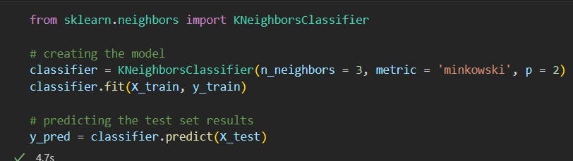
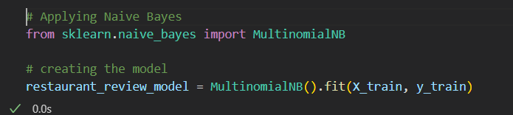
MODEL DEVELOPMENT:
EXPERIMENTED WITH VARIOUS MACHINE LEARNING ALGORITHMS MAINLY KNN AND NAIVE BAYES ALGORITHM WERE USED

Slide 9
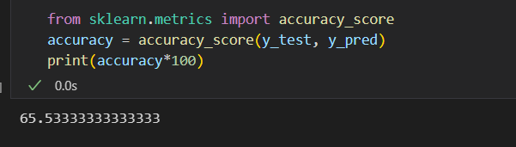
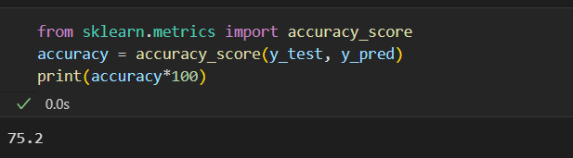
Accuracy
KNN
Naive Bayes Algorithm

Slide 10


links
https://drive.google.com/drive/folders/1_LeugaO8weSfXdzRxPyv_3F7PuGBJ6zZ?usp=drive_link
www.linkedin.com/in/yash-phuke

